Slide 1
Listing problem
Posts and Telecommunication Institute of Technology
Faculty of Information Technology 1
Mathematic discrete1
Ngo Xuan Bach
Dao Thi Thuy Quynh

Slide 2
Contents
Introduction
Generation method
Backtracking method
Exercise

Slide 3
Introduce listing problem
Counting problem: Construct formula that calculate roots of problem
Listing problem: What is root of problem?
Common method to solve the listing problem: Using brute-force algorithm to consider all of possibilities of the combinatorial configurations to give each root of problem
Listing method needs to satisfy 2 conditions:
Do not repeat any configuration
Do not miss any configuration
Steps to solve the problem by computer:
Understand requirements of problem
Choose data structure representing the plan to be considered
Choose suitable algorithm for data structure
Implement algorithm and test program
Optimizing program

Slide 4
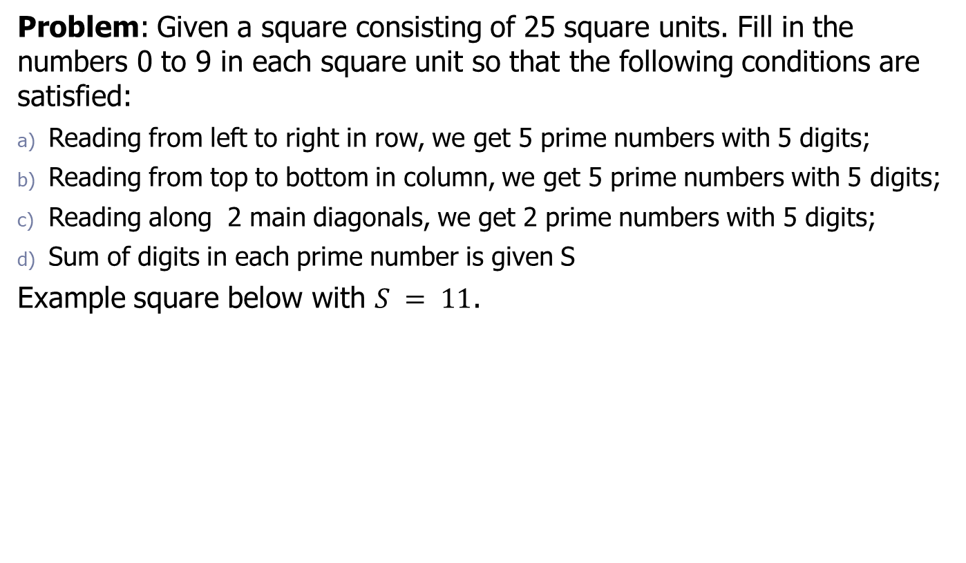
Example 1
Problem: Given a square consisting of 25 square units. Fill in the numbers 0 to 9 in each square unit so that the following conditions are satisfied:
Reading from left to right in row, we get 5 prime numbers with 5 digits;
Reading from top to bottom in column, we get 5 prime numbers with 5 digits;
Reading along 2 main diagonals, we get 2 prime numbers with 5 digits;
Sum of digits in each prime number is given S
Example square below with $S = 11$.
3 | 5 | 1 | 1 | 1
5 | 0 | 0 | 3 | 3
1 | 0 | 3 | 4 | 3
1 | 3 | 4 | 2 | 1
1 | 3 | 3 | 1 | 3

Slide 5
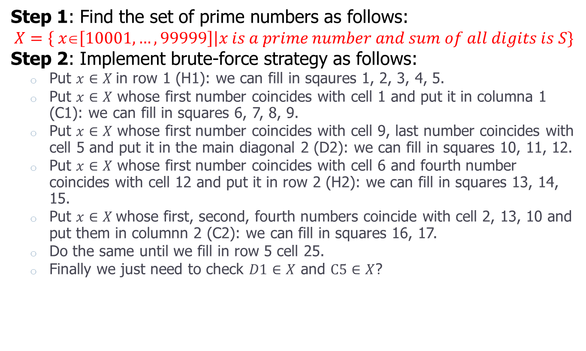
Example 1
Step 1: Find the set of prime numbers as follows:
$$X=\left\{ x∈\left[10001,…,99999\right]\right|x is a prime number and sum of all digits is S\}$$
Step 2: Implement brute-force strategy as follows:
Put $x∈X$in row 1 (H1): we can fill in sqaures 1, 2, 3, 4, 5.
Put $x∈X$ whose first number coincides with cell 1 and put it in columna 1 (C1): we can fill in squares 6, 7, 8, 9.
Put $x∈X$ whose first number coincides with cell 9, last number coincides with cell 5 and put it in the main diagonal 2 (D2): we can fill in squares 10, 11, 12.
Put $x∈X$ whose first number coincides with cell 6 and fourth number coincides with cell 12 and put it in row 2 (H2): we can fill in squares 13, 14, 15.
Put $x∈X$whose first, second, fourth numbers coincide with cell 2, 13, 10 and put them in columnn 2 (C2): we can fill in squares 16, 17.
Do the same until we fill in row 5 cell 25.
Finally we just need to check $D1∈X$ and $C5∈X$?

Slide 6
Example 1
Order of filling numbers
3 | 5 | 1 | 1 | 1
5 | 0 | 0 | 3 | 3
1 | 0 | 3 | 4 | 3
1 | 3 | 4 | 2 | 1
1 | 3 | 3 | 1 | 3
1 | 2 | 3 | 4 | 5
6 | 13 | 14 | 12 | 15
7 | 16 | 11 | 18 | 19
8 | 10 | 20 | 22 | 23
9 | 17 | 21 | 24 | 25

Slide 7
Contents
Introduction
Generation method
Backtracking method
Exercise

Slide 8
Generation algorithm (1/2)
The generation algorithm is used to solve the problems that satisfy 2 conditions:
Determine an order on the set of configurations to be listed for problem. Know the first configuration, know the last configuration.
From a configuration, we can build an algorithm that generates right following configuration

Slide 9
Generation algorithm(2/2)
Step 1 (Init):
<Set up the first configuration>;
Step 2 (Loop):
while (<repeat when not final configuration>) {
<Show current configuration>;
<Generate next configuration>;
}
<Show final configuration>;

Slide 10

Example 2
Problem: List binary strings of length n.
String $X=(x1x2... xn)$: $xi=0, 1;i=1, 2,..., n$ is called a binary string with length $n$. For example, with $n=4$, we have 16 binary strings below:
STT | X =(x₁...x_{n}) | F(X) | STT | X =(x₁...x_{n}) | F(X)
1 | 0000 | 0 | 9 | 1000 | 8
2 | 0001 | 1 | 10 | 1001 | 9
3 | 0010 | 2 | 11 | 1010 | 10
4 | 0011 | 3 | 12 | 1011 | 11
5 | 0100 | 4 | 13 | 1100 | 12
6 | 0101 | 5 | 14 | 1101 | 13
7 | 0110 | 6 | 15 | 1110 | 14
8 | 0111 | 7 | 16 | 1111 | 15

Slide 11

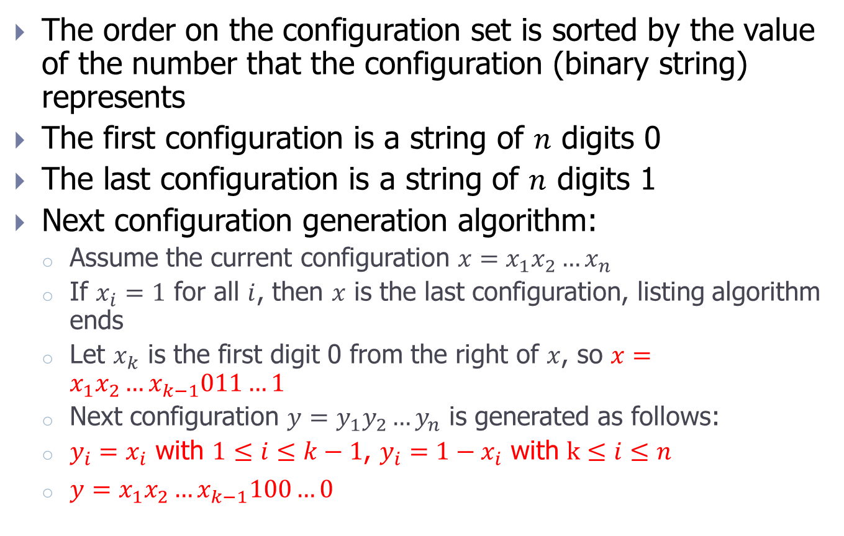
Example 2
The order on the configuration set is sorted by the value of the number that the configuration (binary string) represents
The first configuration is a string of $n$ digits 0
The last configuration is a string of $n$ digits 1
Next configuration generation algorithm:
Assume the current configuration $x=x_{1}x_{2}…x_{n}$
If $x_{i}=1$ for all $i$, then $x$ is the last configuration, listing algorithm ends
Let $x_{k}$ is the first digit 0 from the right of $x$, so $x=x_{1}x_{2}…x_{k−1}011…1$
Next configuration $y=y_{1}y_{2}…y_{n}$ is generated as follows:
$y_{i}=x_{i}$ with $1≤i≤k−1$, $y_{i}=1−x_{i}$ with $k≤i≤n$
$y=x_{1}x_{2}…x_{k−1}100…0$
$$y=x+1$$

Slide 12

Exercise
Exercise 1. Given a rectangle consisting $nm$square units. List all the routes from the bottom vertex of the last unit on the left to the vertex of the top unit on the right. Know that each move is only allowed to the right or up along the edges of the square units.

Slide 13
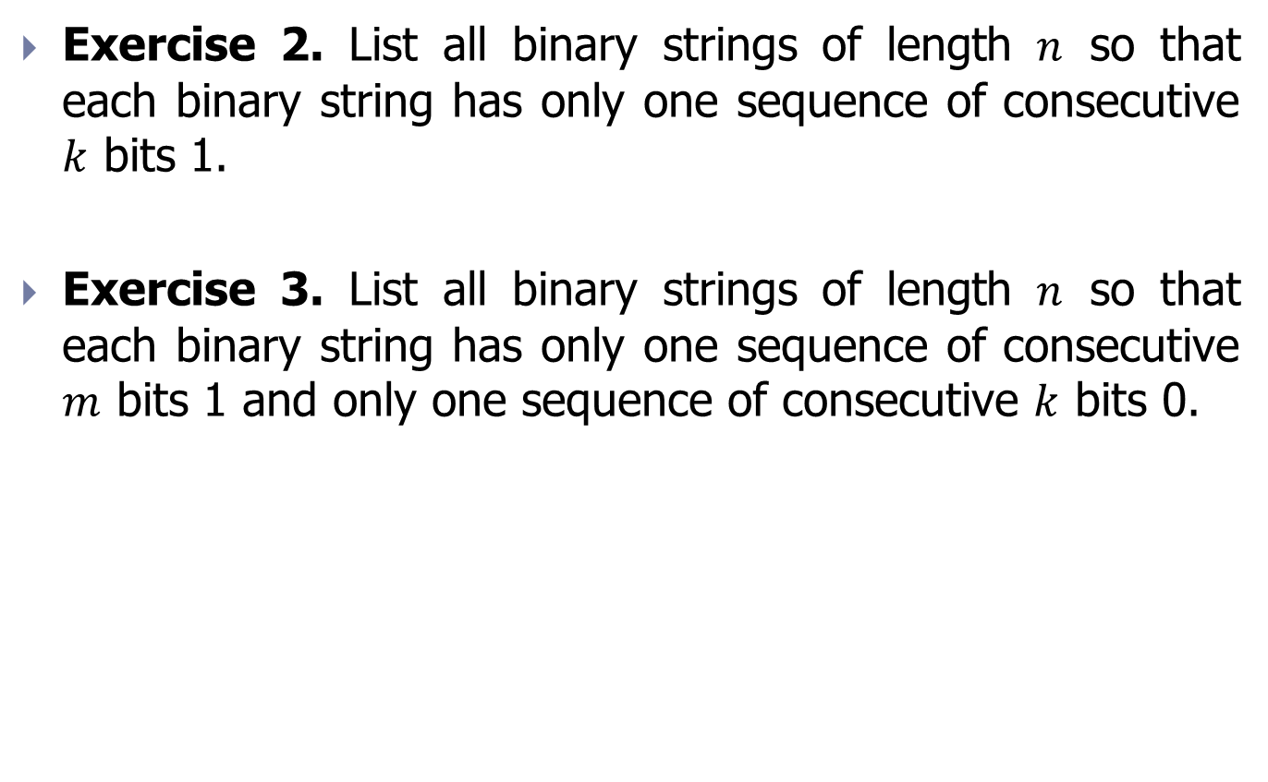
Exercise
Exercise 2. List all binary strings of length $n$ so that each binary string has only one sequence of consecutive $k$ bits 1.
Exercise 3. List all binary strings of length $n$ so that each binary string has only one sequence of consecutive $m$ bits 1 and only one sequence of consecutive $k$ bits 0.

Slide 14
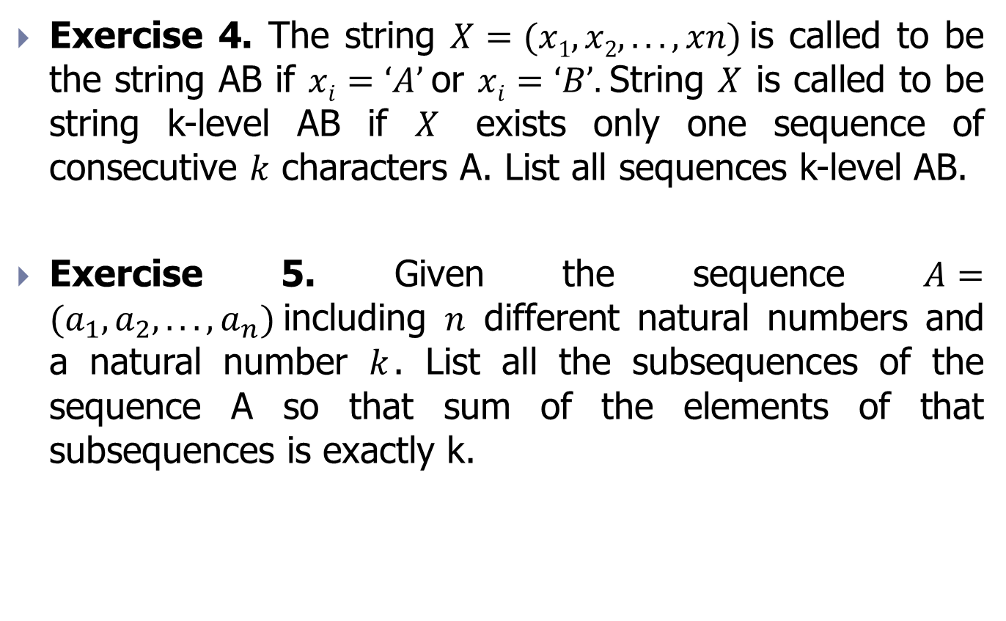
Exercise
Exercise 4. The string $X=(x1,x2,...,xn)$is called to be the string AB if $xi=‘A’$or $xi=‘B’.$String $X$ is called to be string k-level AB if $X$ exists only one sequence of consecutive $k$ characters A. List all sequences k-level AB.
Exercise 5. Given the sequence $A=(a_{1}, a_{2},...,a_{n})$including $n$ different natural numbers and a natural number $k$. List all the subsequences of the sequence A so that sum of the elements of that subsequences is exactly k.

Slide 15
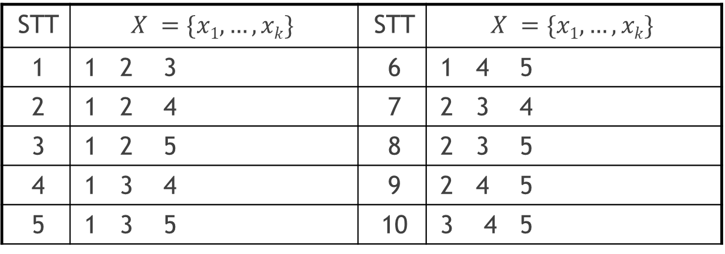

Example 3
List all combinations $k$ of $1, 2,…, n$.
Each combination $k$ of $1, 2,…, n$ is a subset of $k$ different elements of $1, 2,…, n$.
Example with $n=5$, $k= 3$ we have $C_{n}^{k}$ subset below:
STT | $$X =\{x1,…,xk\}$$ | STT | $$X =\{x1,…,xk\}$$
1 | 1 2 3 | 6 | 1 4 5
2 | 1 2 4 | 7 | 2 3 4
3 | 1 2 5 | 8 | 2 3 5
4 | 1 3 4 | 9 | 2 4 5
5 | 1 3 5 | 10 | 3 4 5

Slide 16
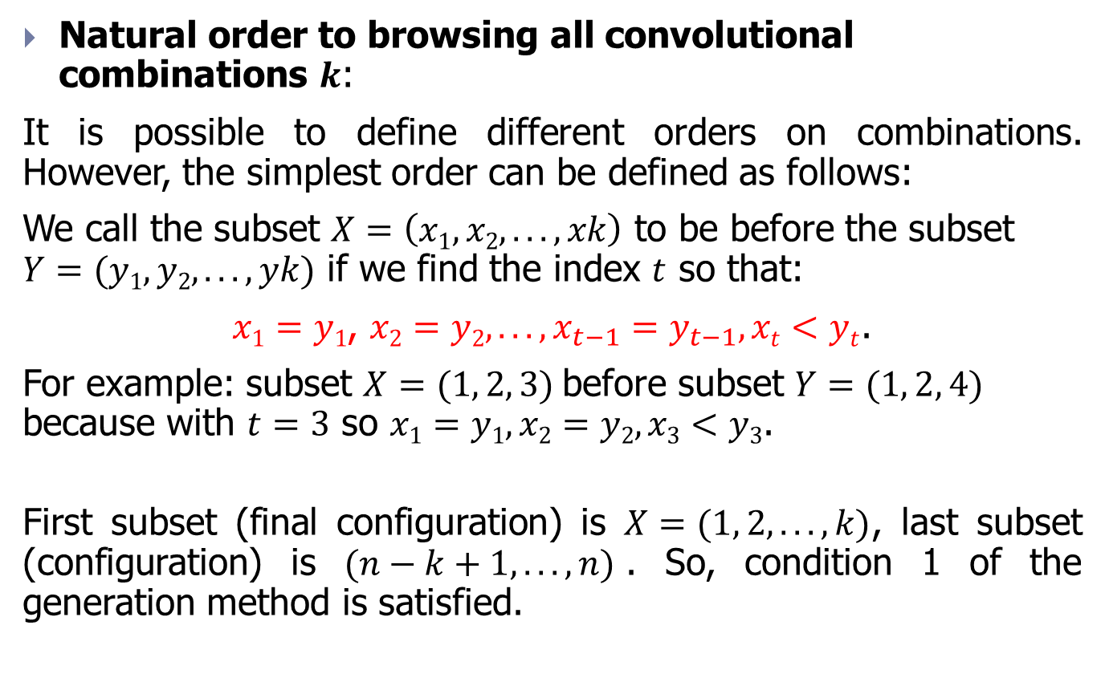
Example 3
Natural order to browsing all convolutional combinations $k$:
It is possible to define different orders on combinations. However, the simplest order can be defined as follows:
We call the subset $X=\left(x1,x2,...,xk\right)$ to be before the subset $Y=(y1,y2,...,yk)$ if we find the index $t$ so that:
$x1=y1$, $x2=y2,..., x_{t−1}=y_{t−1}, xt<yt$.
For example: subset $X=(1, 2, 3)$before subset $Y=(1, 2, 4)$ because with $t=3$ so $x1=y1, x2=y2, x3<y3$.
First subset (final configuration) is $X=(1, 2,...,k)$, last subset (configuration) is $(n−k+1,...,n)$. So, condition 1 of the generation method is satisfied.

Slide 17
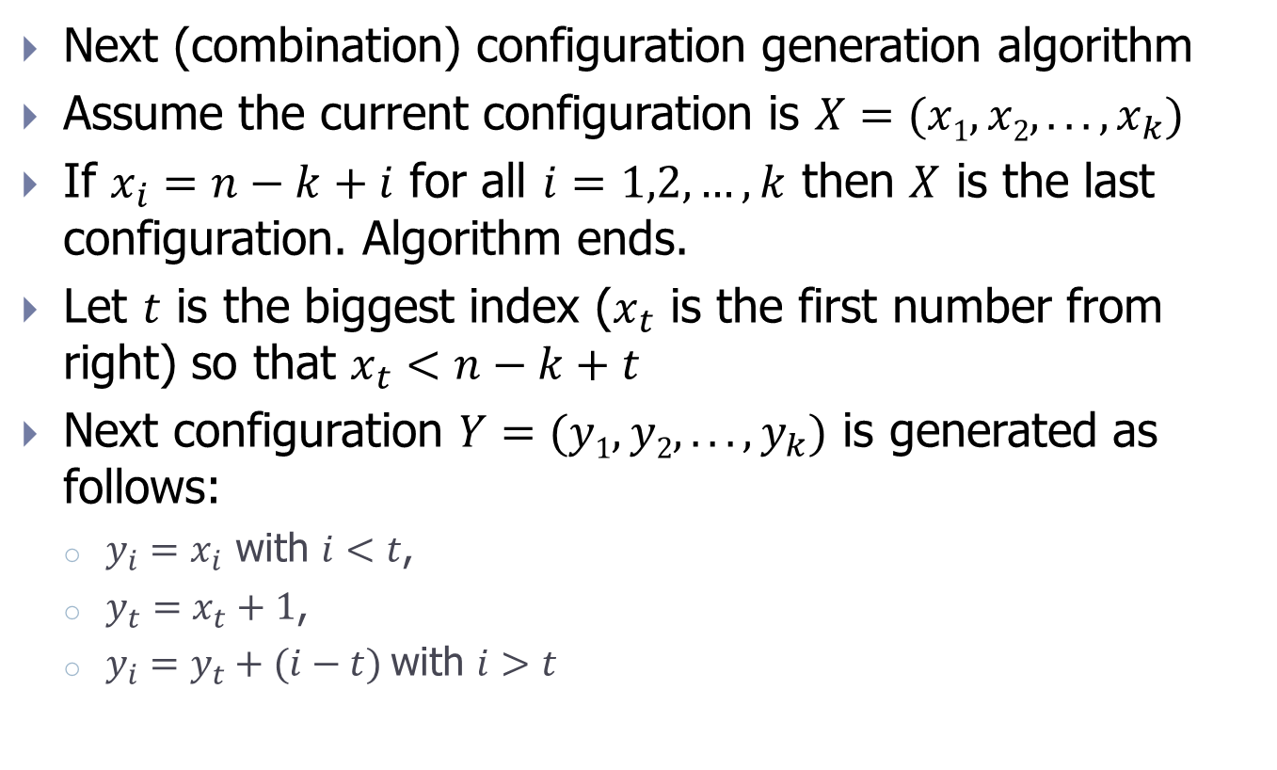
Example 3
Next (combination) configuration generation algorithm
Assume the current configuration is $X=(x1,x2,...,x_{k})$
If $x_{i}=n−k+i$ for all $i=1,2,…,k$ then $X$ is the last configuration. Algorithm ends.
Let $t$ is the biggest index ($x_{t}$ is the first number from right) so that $x_{t}<n−k+t$
Next configuration $Y=(y1,y2,...,y_{k})$ is generated as follows:
$y_{i}=x_{i}$ with $i<t$,
${y_{t}=x}_{t}+1$,
$y_{i}=y_{t}+(i−t)$with $i>t$

Slide 18
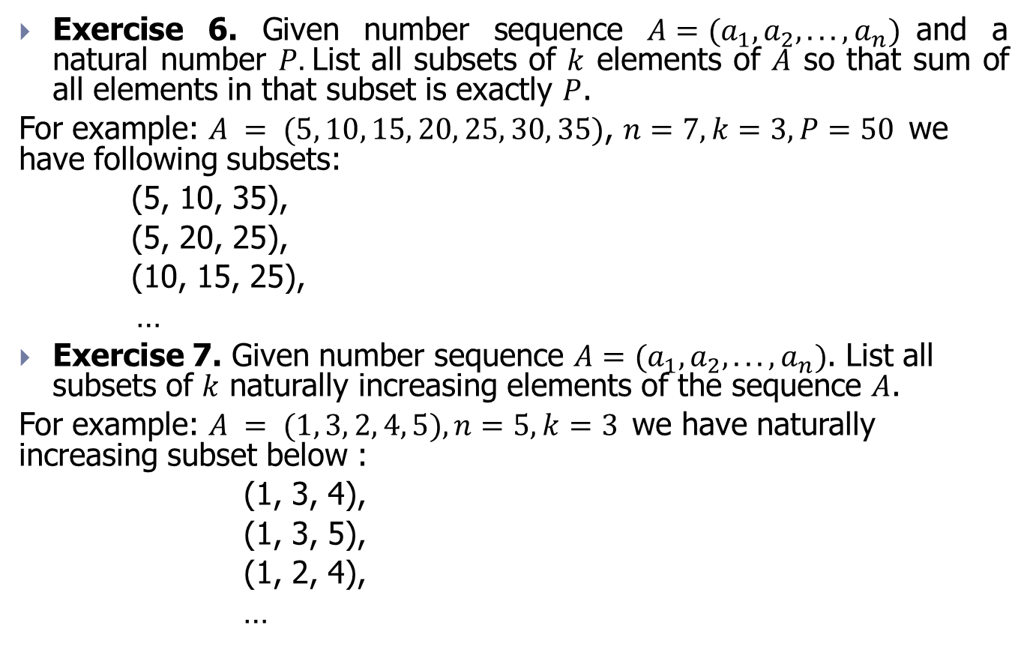
Exercise
Exercise 6. Given number sequence $A=(a_{1}, a_{2},...,a_{n})$and a natural number $P.$List all subsets of $k$ elements of $A$ so that sum of all elements in that subset is exactly $P$.
For example: $A = (5, 10, 15, 20, 25, 30, 35)$, $n=7, k=3, P=50$we have following subsets:
(5, 10, 35),
(5, 20, 25),
(10, 15, 25),
…
Exercise 7. Given number sequence $A=(a_{1}, a_{2},...,a_{n})$. List all subsets of $k$ naturally increasing elements of the sequence $A$.
For example: $A = (1, 3, 2, 4, 5), n=5, k=3$we have naturally increasing subset below :
(1, 3, 4),
(1, 3, 5),
(1, 2, 4),
…

Slide 19
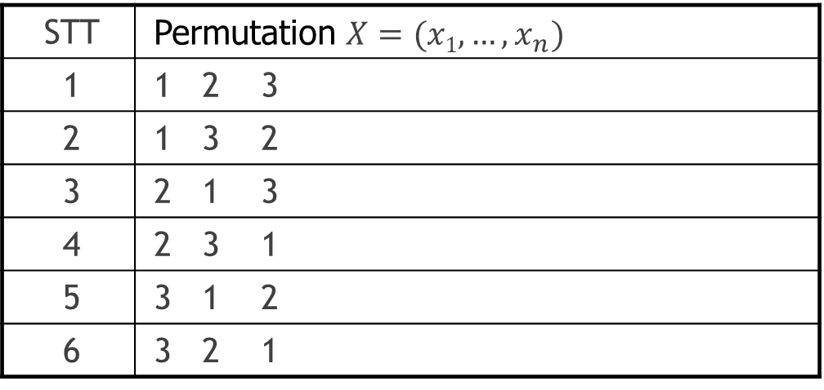

Example 4
List permutations of $1,2,…,n$.
Each permutation of $1,2,…,n$ is a way to arrange by order of $1,2,…,n$. Number of permutations is $n!$. For example, with $n=3$ we have 6 following permutations:
STT | Permutation $X=(x1,…,x_{n})$
1 | 1 2 3
2 | 1 3 2
3 | 2 1 3
4 | 2 3 1
5 | 3 1 2
6 | 3 2 1

Slide 20
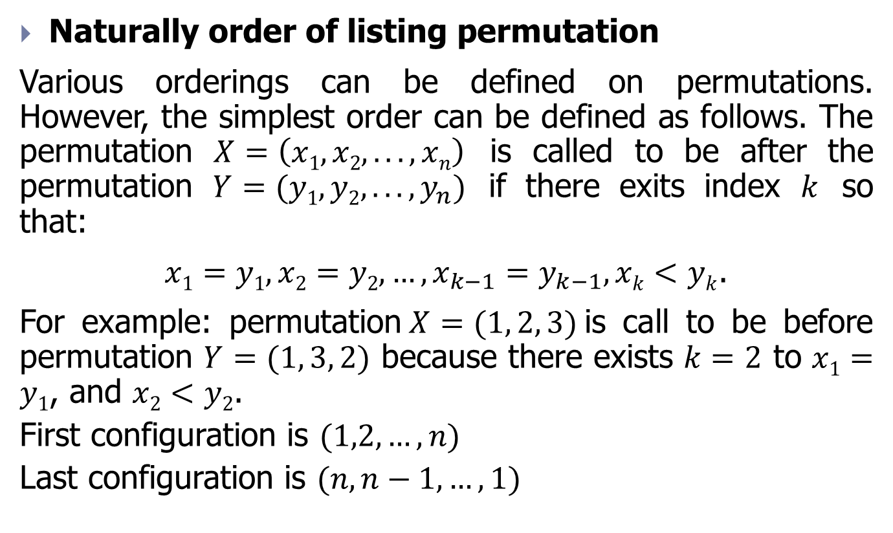
Example 4
Naturally order of listing permutation
Various orderings can be defined on permutations. However, the simplest order can be defined as follows. The permutation $X=\left(x1, x2,..., xn\right)$ is called to be after the permutation $Y=(y1, y2,...,y_{n})$ if there exits index $k$ so that:
$x1=y1, x2=y2,…,x_{k−1}=y_{k−1}, xk<yk$.
For example: permutation$X=(1, 2, 3)$is call to be before permutation $Y=(1, 3, 2)$ because there exists $k=2$ to $x1=y1$, and $x2<y2$.
First configuration is $(1,2,…,n)$
Last configuration is $(n,n−1,…,1)$

Slide 21
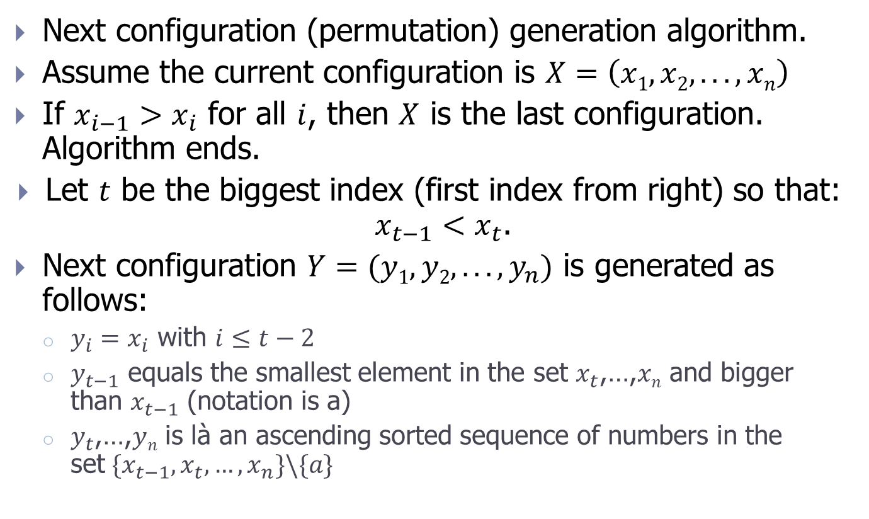
Example 4
Next configuration (permutation) generation algorithm.
Assume the current configuration is $X=\left(x1, x2,..., xn\right)$
If $x_{i−1}>x_{i}$ for all $i$, then $X$ is the last configuration. Algorithm ends.
Let $t$ be the biggest index (first index from right) so that: $x_{t−1}<x_{t}$.
Next configuration $Y=(y1, y2,...,y_{n})$ is generated as follows:
$y_{i}=x_{i}$ with $i≤t−2$
$y_{t−1}$ equals the smallest element in the set $x_{t}$,…,$xn$ and bigger than $x_{t−1}$ (notation is a)
$y_{t}$,…,$yn$ is là an ascending sorted sequence of numbers in the set${ \{x}_{t−1},x_{t},…,x_{n}\}\backslash \{a\}$

Slide 22
Contents
Introduction
Generation method
Backtracking method
Exercise

Slide 23
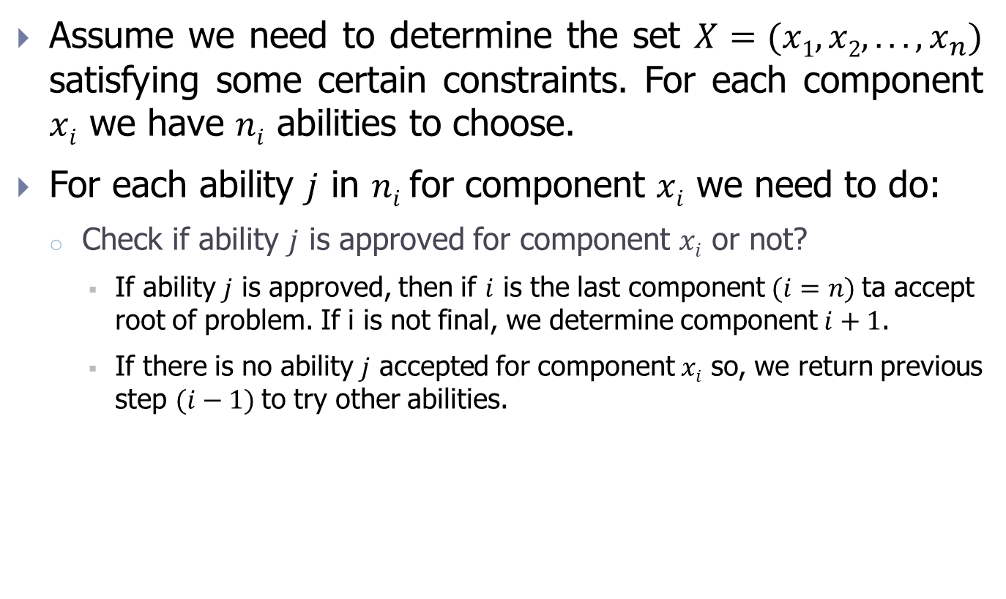
Backtracking algorithm (1/2)
Assume we need to determine the set $X=(x1, x2,...,x_{n})$ satisfying some certain constraints. For each component $xi$ we have $ni$ abilities to choose.
For each ability $j$ in $ni$for component $xi$ we need to do:
Check if ability $j$ is approved for component $xi$ or not?
If ability $j$ is approved, then if $i$ is the last component $(i=n)$ta accept root of problem. If i is not final, we determine component $i+1$.
If there is no ability $j$ accepted for component $xi$ so, we return previous step $(i−1)$to try other abilities.

Slide 24
Backtracking algorithm (2/2)
Back_Track (int i ) {
for ( j =<Ability 1>; j <=n_{i}; j++ ){
if (<Accept ability j>) {
X[i] = <Ability j>;
if ( i ==n)
Result();
else
Back_Track(i+1);
}
}

Slide 25
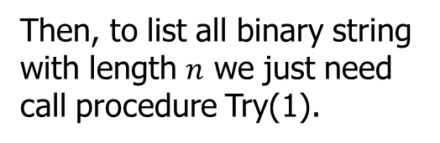

Exercise 5
List all binary strings with length of $n$.
String $X=(x1x2... xn)$: $xi=0, 1;i=1, 2,..., n$ is a binary string with length of $n$.
void Try ( int i ) {
for (int j =0; j<=1; j++){
X[i] = j;
if ( i ==n)
Result();
else
Try (i+1);
}
}
Then, to list all binary string with length $n$ we just need call procedure Try(1).

Slide 26













Example 5
Try(1)
$$x_{1}=0$$
$$x_{1}=1$$
Try(2)
Try(2)
$$x_{2}=1$$
$$x_{2}=0$$
$$x_{2}=1$$
$$x_{2}=0$$
Try(3)
Try(3)
Try(3)
Try(3)
$$x_{3}=0$$
$$x_{3}=1$$
$$x_{3}=0$$
$$x_{3}=1$$
$$x_{3}=0$$
$$x_{3}=1$$
$$x_{3}=0$$
$$x_{3}=1$$
0 0 0
0 0 1
0 1 0
0 1 1
1 0 0
1 0 1
1 1 0
1 1 1

Slide 27
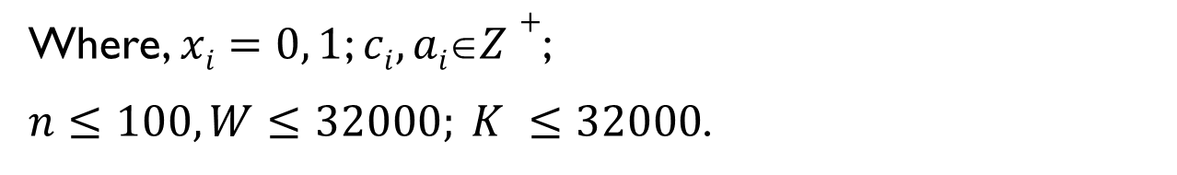
Exercise
Exercise 9. Using backtracking algorithm, list all elements of set:
Where, $xi=0, 1$; $ci, aiZ+$;
$n≤100, W≤32000; K ≤32000$.

Slide 28

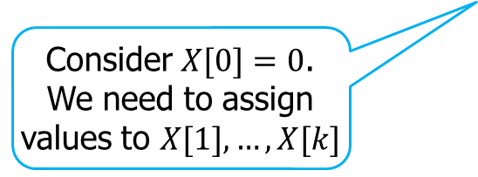
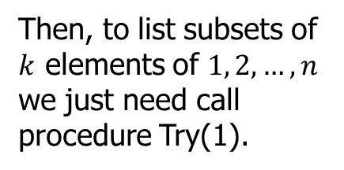
Example 6
List all combinations $k$ of $1, 2,…, n$.
Each convolutional combinations $k$ of $1, 2,…, n$ is a subset of $k$ different elements of $1, 2,…, n$.
void Try ( int i ) {
for (int j =X[i-1]+1; j<=n-k+ i; j++){
X[i] = j;
if ( i ==k)
Result();
else
Try (i+1);
}
}
Then, to list subsets of $k$ elements of $1, 2, …, n$ we just need call procedure Try(1).
Consider $X[0]=0$.
We need to assign values to $X[1],…,X[k]$

Slide 29
Example 6
Try(1)
X1=1
X1=3
X1=2
Try(2)
Try(2)
Try(2)
X2=2
X2=3
X2=4
X2=4
X2=3
X2=4
Try(3)
Try(3)
Try(3)
Try(3)
Try(3)
Try(3)
X3=3
X3=4
X3=5
X3=4
X3=5
X3=5
X3=4
X3=5
X3=5
X3=5
1 2 3
1 2 4
1 2 5
1 3 4
1 3 5
1 4 5
2 3 4
2 3 5
2 4 5
3 4 5

Slide 30
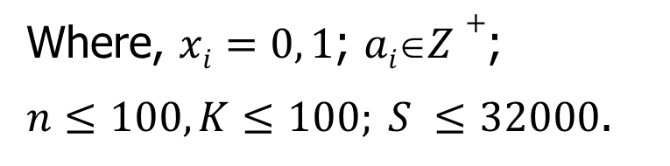
Exercise
Exercise 10. Using backtracking algorithm, list all elements of set:
Where, $xi=0, 1$; $aiZ+$;
$n≤100, K≤100; S ≤32000$.

Slide 31
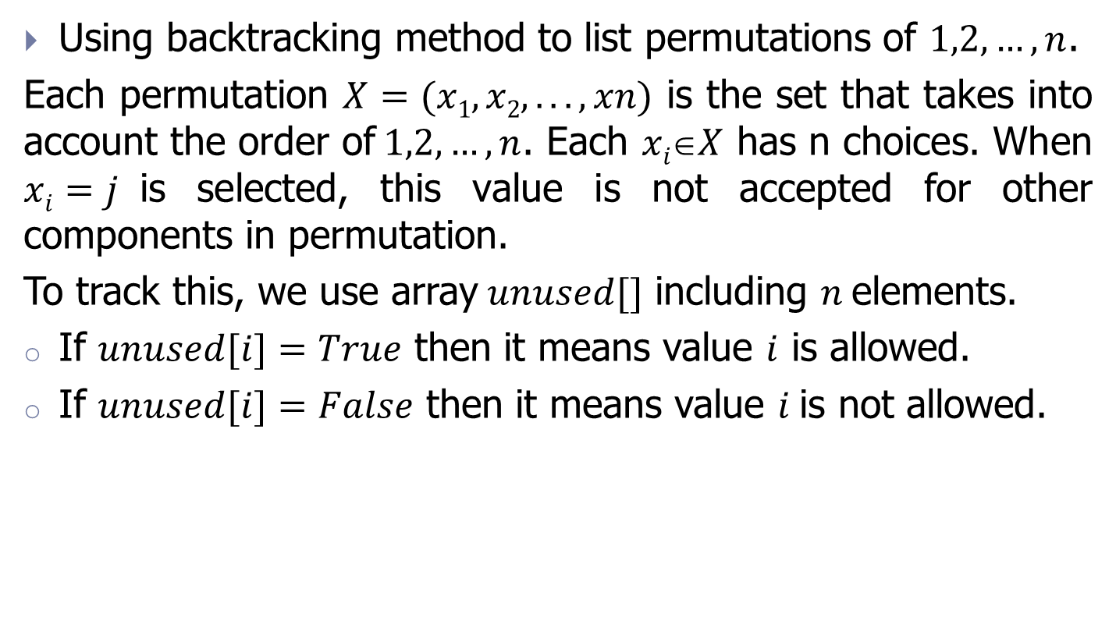
Example 7
Using backtracking method to list permutations of $1,2,…,n$.
Each permutation $X=(x1, x2,...,xn)$ is the set that takes into account the order of$1,2,…,n$. Each $xiX$ has n choices. When $xi=j$is selected, this value is not accepted for other components in permutation.
To track this, we use array$unused[]$ including $n$elements.
If $unused[i]=True$ then it means value $i$ is allowed.
If $unused[i]=False$ then it means value $i$is not allowed.

Slide 32
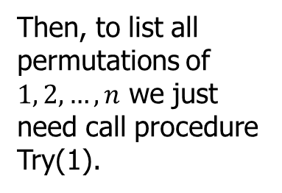
Example 7
void Try ( int i ) {
for (int j =1; j<=n; j++){
if (unused[j] ) {
X[i] = j;
unused[j] = false;
if ( i ==n)
Result();
else
Try (i+1);
unused[j] = true;
}
}
}
Then, to list all permutations of $1, 2, …, n$ we just need call procedure Try(1).

Slide 33
Example 7
Try(1)
X1=1
X1=3
X1=2
Try(2)
Try(2)
Try(2)
X2=2
X2=3
X2=1
X2=3
X2=1
X2=2
Try(3)
Try(3)
Try(3)
Try(3)
Try(3)
Try(3)
X3=3
X3=2
X3=3
X3=1
X3=2
X3=1
1 2 3
1 3 2
2 1 3
2 3 1
3 1 2
3 2 1

Slide 34
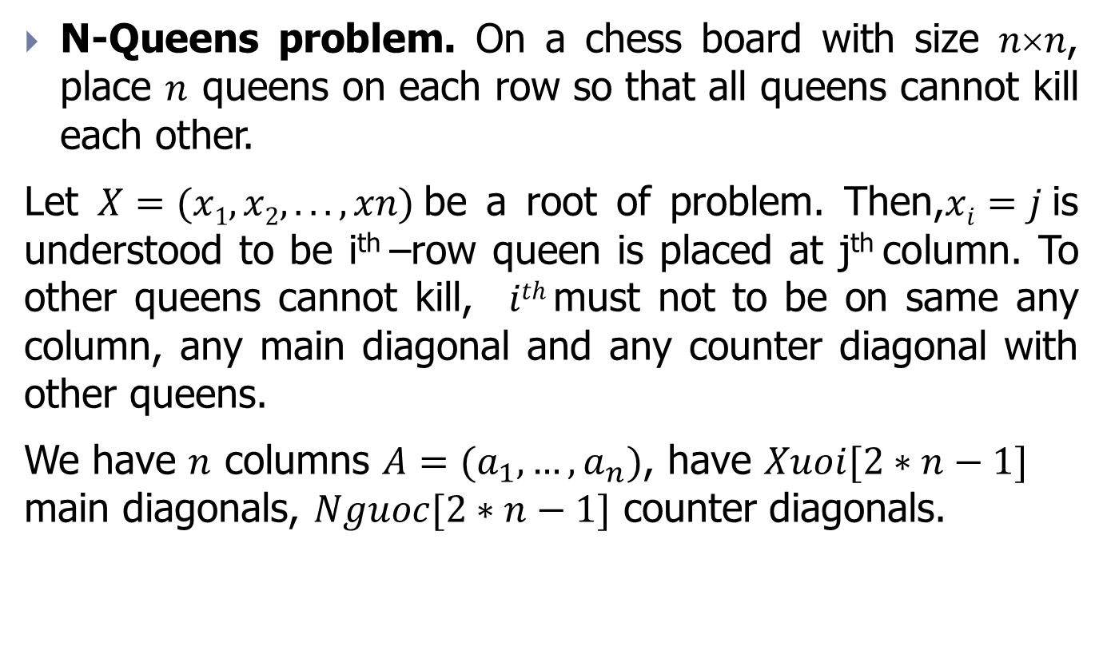
Example 8
N-Queens problem. On a chess board with size $nn$, place $n$ queens on each row so that all queens cannot kill each other.
Let $X=(x1, x2,...,xn)$be a root of problem. Then,$xi=j$is understood to be i^{th} –row queen is placed at j^{th} column. To other queens cannot kill, $ith$must not to be on same any column, any main diagonal and any counter diagonal with other queens.
We have $n$ columns $A=(a_{1},…,a_{n})$, have $Xuoi[2∗n−1]$ main diagonals, $Nguoc[2∗n−1]$ counter diagonals.

Slide 35


Example 8
Diagonal forward : $Xuoi [i –j+n]$
Reverse diagonal : $Nguoc [i+j−1]$
 |  |  |  |  |  |  | 1
 |  |  |  |  |  |  | 2
 |  |  |  |  |  |  | 3
 |  |  |  |  |  |  | 4
 |  |  |  |  |  |  | 5
 |  |  |  |  |  |  | 6
 |  |  |  |  |  |  | 7
15 | 14 | 13 | 12 | 11 | 10 | 9 | 8
1
2
3
4
5
6
7
8 | 9 | 10 | 11 | 12 | 13 | 14 | 15

Slide 36
Example 8
void Try (int i){
for(int j=1; j<=n; j++){
if( A[j] && Xuoi[ i - j + n ] && Nguoc[i + j -1]){
X[i] =j;
A[j]=false;
Xuoi[ i - j + n]=false;
Nguoc[ i + j - 1]=false;
if(i==n) Result();
else Try(i+1);
A[j] = true;
Xuoi[ i - j + n] = true;
Nguoc[ i + j - 1] = true;
}
}
}
Then, to solve the Queen problem, we just need to call the procedure Try(1).

